Slide 1
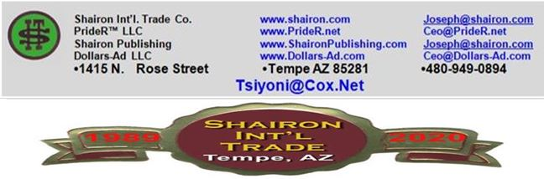
Patent Presented By
Joseph Tsiyoni, CEO
Online Gradual Price Reduction Patent –
Goods & Services
(AKA INTERNET TRADING; U.S. Patent 8359230)
ALSO: Tsiyoni’s Patent & Copyrighted Mathematical Formula Joseph Tsiyoni, Founder, Inventor, President Tsiyoni@cox.net

Slide 2


Problem
eBay (1.7 B Ads Daily) | Powerful | Largest
●Auctions Only ● Same Old Methods
●Auctions Decreases Significantly
●Boring ●Excitement Gone
●7-10 Days waiting Not Acceptable
●Became Mostly Internet Store
●Buyers Become Impatient
●Sellers Reluctantly Satisfy With Initial Price
2. All Auction Sites | Despite Millions of Auctions, All Sites Experience Same Problems
Sellers Still Want To sell Anyway, But Changes Will Revive Industry

Slide 3

●A New Patent – Internet Trading (Goods & Services)
●A New Method of Gradual Price Reduction™: Price Is
Gradually Reduced @ Unknown %, Unknown Time!
● New: Based On Tsiyoni’s © Mathematical Formula
●A New Spirit; Interesting, Revolutionary Methods
●Buyer “Grabs” Item – Ending Posting – Starting a New One
●Reduces Posting Duration
●Retailers Can Brilliantly Implement Existing Price Model
●Will Take Portion of Existing “Internet Stores” Model
Shairon Solution
Time For Change; Industry Carves For It !

Slide 4

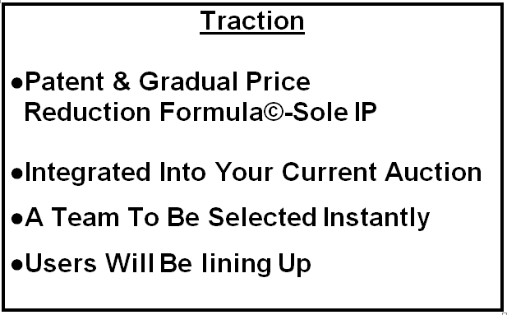

Slide 5
Market Opportunity
●Millions Individuals Selling On Internet
●Many Business Selling Goods & Services
●Frustrated Sellers With Auction Types
●’High Priced’ items Sellers
●’Gave-Up’ Sellers Recognizing and Waiting A New Spirit, Exciting New Method
●Major Retailers May Purchase Licensing
Gradual Price Reduction© May Take Over Auctions Method Gradually!

Slide 6
Business Model
Customers: Entire public Businesses Dealers: Cars, Goods Venture Website (to Improve) Professional Team eBay type of Model, based on Patent & Mathematical Formula
Operation: Forming LLC Operational Web Sales & Marketing P.R., Networking Own Server, IT IP Obtained, Solely Owned
UNDERLYING MAGIC: The Only Site To Use Our Patented “Gradual Price Reduction™.

Slide 7
Competitive Advantage
ALL COMPETITION:
Shairon
●Use Mostly ‘Auctions’
● Exclusive Patent/Formula
●eBay: 1.7 B Ads Daily
● Changing Industry: Alternative to All Auctions
●Different Auctions Types
●Specific Item Auctions
● Gradual Price Reduction™
Method: Tsiyoni’s Formula
●Real Time Auctions
● Exciting & Interesting: Will Encourage Switch To !
●Online Stores–Fixed Prices
● Better Than “But It Now”
All Auction Sites Use The Same General Principle of Auction, Including ‘Buy It Now’.
● Licensing Potential
Revolutionizing Internet Trading; Alternative To Auctions (May Include)

Slide 8
Marketing & Sales Strategy
------------------------------------------------------------------------
Shairon Internet Trade
U.S. Marketing
Retailers Association
Marketing &
Sales
Licensing or Selling Rights
●Telemarketing
● Internet Sales
● P.R.
● Emails
● T.V.
● Business Contact

Slide 9
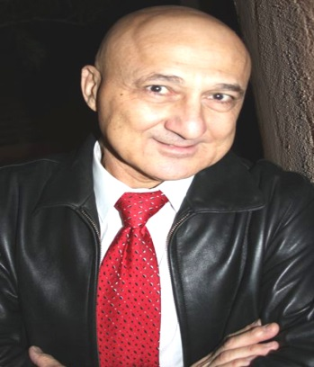

Management Team
Joseph Tsiyoni, CEO
Founder, owner, Architect & CEO, Dollars-AD.com⇨
●B.A. - Pub. Admin, Law; Accounting, MS, Web Design
●30 years Experience: Exec. Auditor, HR Dir., Analyst
●28 years entrepreneur, owner, S.I.T. invention company
●Inventor, manufacturer, author of 16 books
●Recipient of dozens of efficiency awards
●19 years-owner, SofiDent Dental: Import & Distribution
●Inventor, designer, manufacturer: PrideR, PrideR.com
Rob Loy –
V/P Technology
V/P Marketing
●V/P of Marketing Will be recruited at the right time.

Slide 10
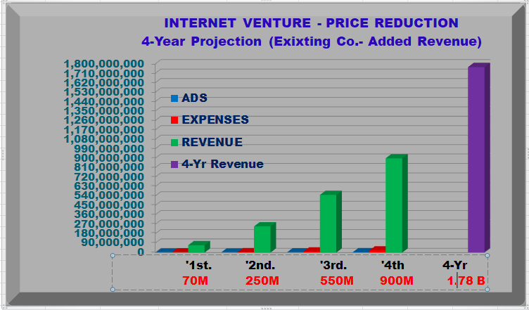
4-YEAR PROJECTION

Slide 11
Investment & Exit Summary
INVESTMENT
EXIT & ROI
●Investment: $1,100,000
●Valuation: $4,000,000
● Ownerships: Buy-Out
● USE OF FUND:
IT+Website: 100K
Operation: 100K
Personnel: 400K
Marketing: 500K
●M&A:
●Merger may be with
major or Smaller Auction
Companies.
●ACQUISITION:
eBay Acquired Korean
Internet Auction, Ltd.
As Site Growth,
Acquisition Possibilities
Increases

Slide 12
Thank you for your time!
Questions?
Joseph Tsiyoni, President
Joseph@Shairon.com & Tsiyoni@cox.net
480-949-0894
www.shairon.com;
Tsiyoni’s Patent & Copyrighted Mathematical Formula Will Bring A Major Change in Online Trading!

